Slide 1



Wi-Fi Based Indoor Navigation System for Android devices
BSc (Hons) Computer Networking and IT Security
(Final Year Project)
January 07, 2015
Presenter : Abhijeet Sapkota
ID : 12065081
Year : 3 (L3N5)
Supervised by : Roshan Chaudhary,
: Ashok Dhungana

Slide 2
Outline:
Introduction
Problem Domain
Aims and Objective
System Architecture
Testing and Results
Conclusion
Reference

Slide 3
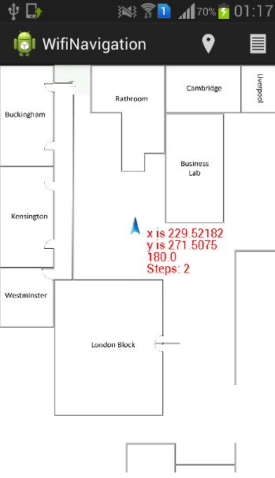

Introduction:
An indoor navigation system developed for Islington College to find the position of person with android mobile device inside the premises.
Using just Wi-Fi Access Points and with Wi-Fi
Received Signal Strength Identifier Fingerprinting
(RSSI) technique.
No use of GPS (Global Positioning System)
RSSI fingerprint which is saved in a file is used to
determine the position of the mobile user.

Slide 4


Problem Domain:
Previous navigation systems are focused on outdoors.
GPS is not suitable for indoor positioning.
GPS requires unobstructed view of the sky and does
not work indoors.
Indoor positioning systems used expensive sensor
network.
Source: slideshare.net.
Access Points used for Wireless LAN can be used for positioning.

Slide 5



Aims and Objective:
Design and develop a system to locate users indoors.
Determining position by comparing real time Wi-Fi RSS signal and RSS fingerprint file.
Help user to navigate inside large and complex indoor environment.
Can be used in Museums. Shopping mall, Airports and campuses.
Museums
Shopping Mall
Airport

Slide 6
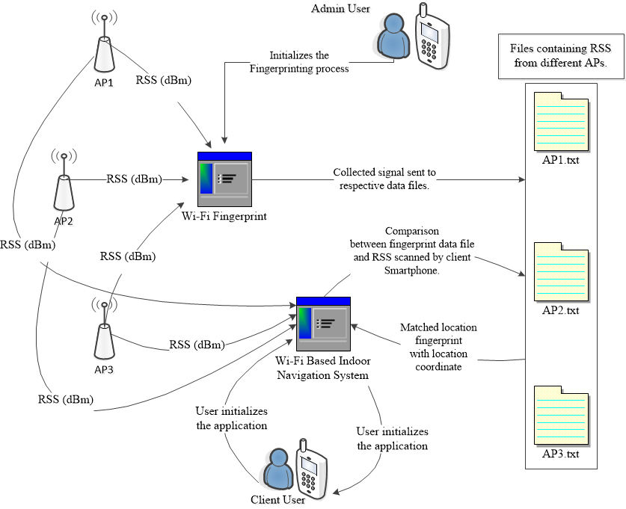
System Architecture:

Slide 7
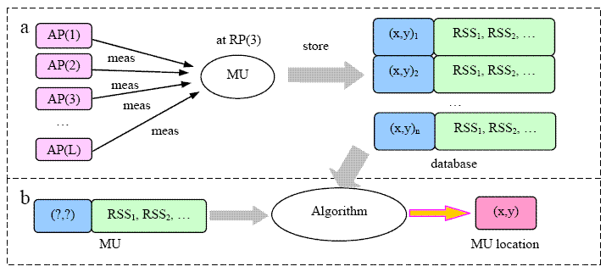


System Architecture (2):
Phase 1
Training
Phase 2
Matching
RSSI scanned from user.
Determined position of user.

Slide 8
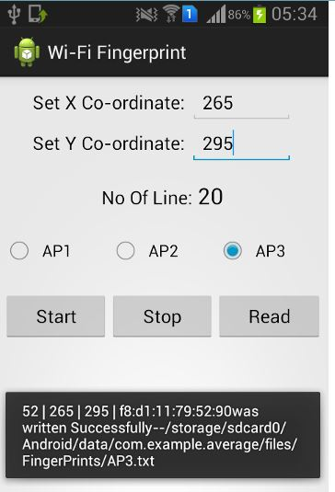
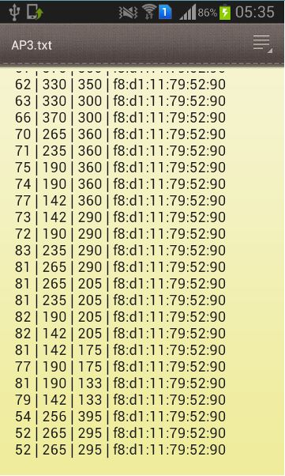

Testing and Results:
Fingerprint Process
MAC Address
Signal Strength
X & Y coordinates

Slide 9
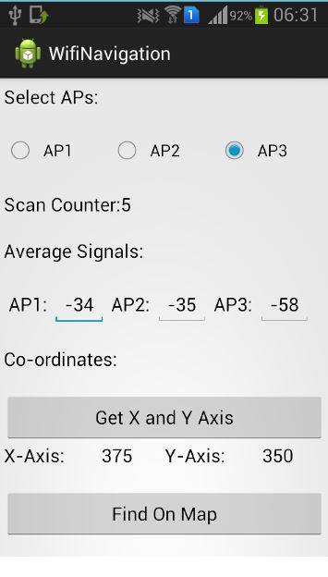
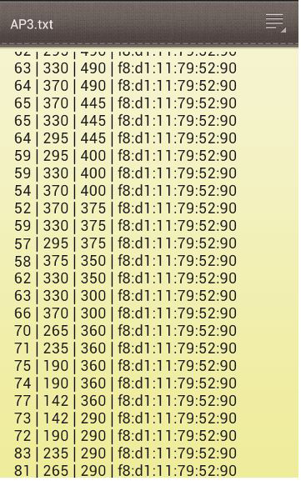
Testing and Results(2):
Position determination process:

Slide 10
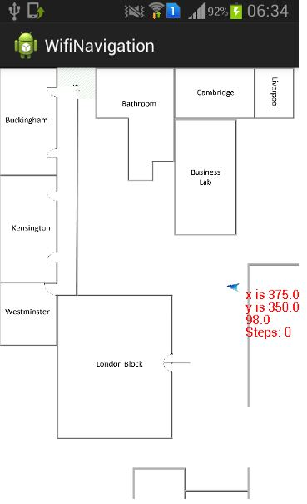
Testing and Results(3):
Position determination process:
Accelerometer sensor and device orientation sensors are used to determine “Movement” and “Direction” of a mobile device.

Slide 11

Conclusion:
Available Wi-Fi infrastructure can be used to develop an indoor navigation system.
Wi-Fi Access Points (APs) can be used for indoor positioning rather using GPS satellites providing weak signals at indoor environment.
Helps any person with android mobile device to navigate
inside large and huge indoor environment.
Future Work:
Problems found during position estimation:
Due to the signal strength fluctuation:
Same position have different signal strength value.
Different position may have same signal strength value.

Slide 12
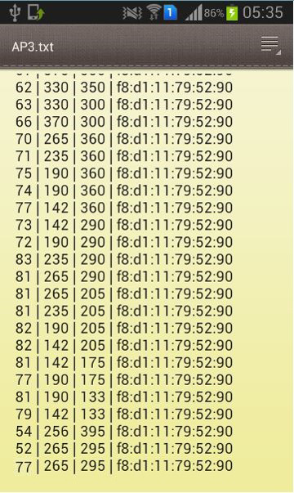
Different position with same signal strength.
Future Work (2):
Same position with different signal strength.

Slide 13
References:
Aebi, F., 2012. Implementation of an Autonomous Indoor Navigation System on Android, Switzerland: Software Engineering Group Department of Informatics University of Fribourg.
Android, 2014. Android Developer Tools. [Online]
Available at: http://developer.android.com/tools/help/adt.html
[Accessed 25 Oct 2014].
Babu, S., 2014. Robots can now locate objects with RFID tags. [Online]
Available at: http://techliveinfo.com/robots-can-now-locate-objects-rfid-tags/
Baruch, M., 2011. Indoor localization by WiFi. Issue IEEE International Conference, pp. 449-452.
Beal, V., 2014. Wifi. [Online]
Available at: http://www.webopedia.com/TERM/W/Wi_Fi.html
Burhum, R., Sep 14, 2012. GeoMeetup - WiFiSLAM - Modern Innovations in Indoor Positioning (Joseph Huang). [Online]
Available at: http://www.youtube.com/watch?v=OGdvjvla1Tc
[Accessed 31 March 2014].
Choudhury, A., 2011 Dec 15. Prototyping Model. [Online]
Available at: http://www.sdlc.ws/prototyping-model/
[Accessed 18 Oct 2014].
Encyclopædia Britannica, Inc. , 2014 Feb 2014. GPS. [Online]
Available at: http://www.britannica.com/EBchecked/topic/235395/GPS
[Accessed 15 Oct 2014].
Francis, J. W., 2011. A quick tutorial on coding Android's accelerometer. [Online]
Available at: http://www.techrepublic.com/blog/software-engineer/a-quick-tutorial-on-coding-androids-accelerometer/
Janalta interactive Inc, 2010-2014. Android SDK. [Online]
Available at: http://www.techopedia.com/definition/4220/android-sdk
[Accessed 18 Oct 2014].

Slide 14
Thank You

